Slide 1
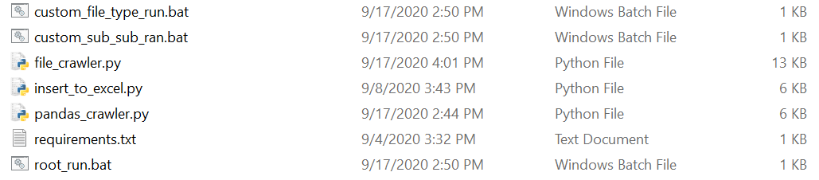
How To Execute File_Crawler
We should have Python 3 or above installed on host. And all the following files in the same place:

Slide 2
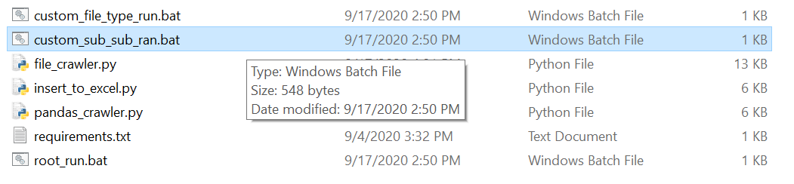
Next Step
Execute desired analysis’s .bat file

Slide 3
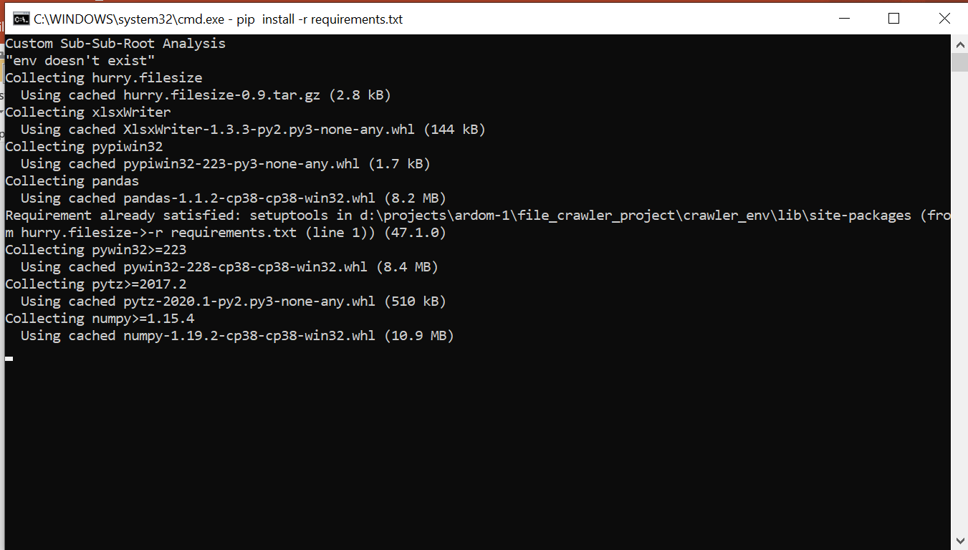
Next Step
The .bat file will lunch a CMD and will create an environment and install all dependencies if needed.

Slide 4
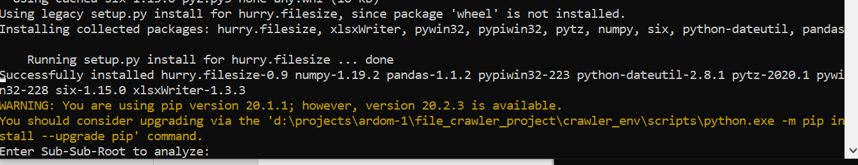
Next Step
The .bat will then run the Python script and considering the .bat we chose the Python script will ask us for input

Slide 5
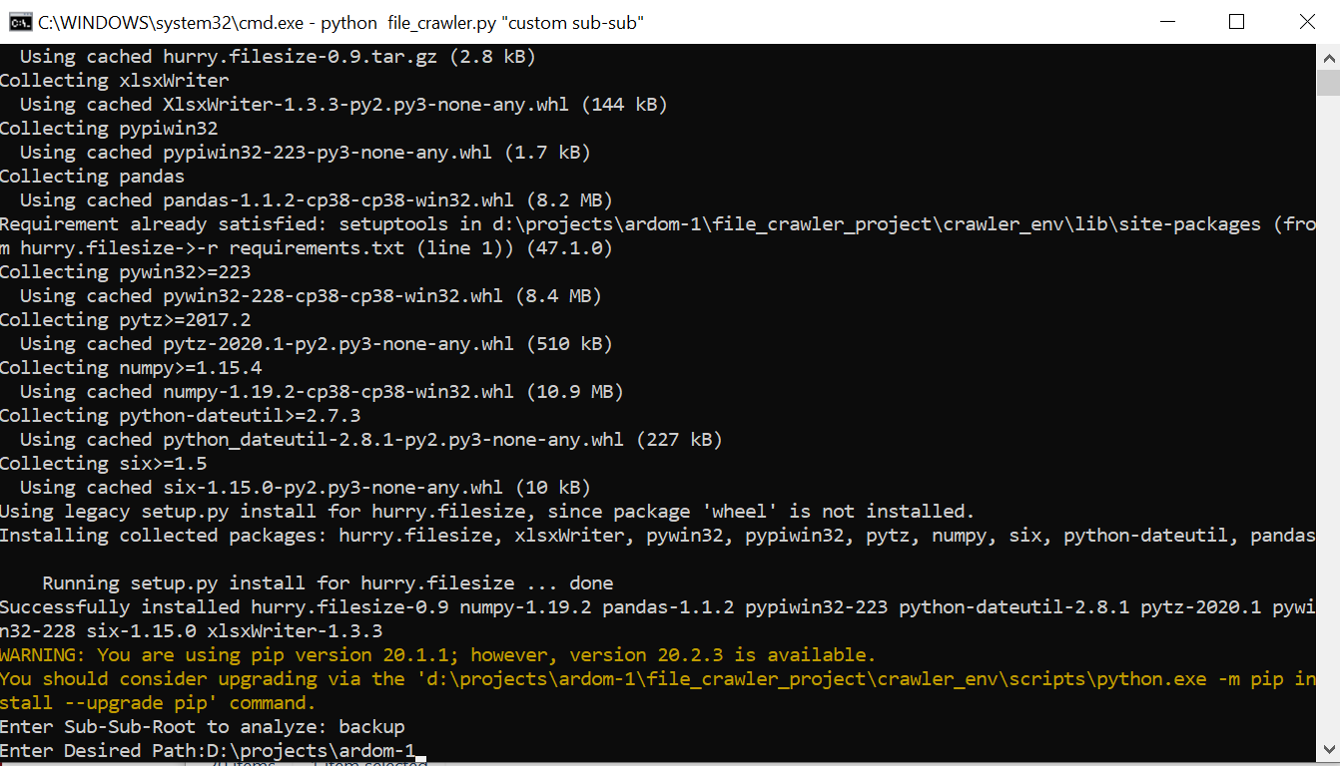
Next Step
Answer the script – in this case I answered ‘backup’ for first question, and ‘D:\projects\ardom-1’ for the second. Then run it.

Slide 6
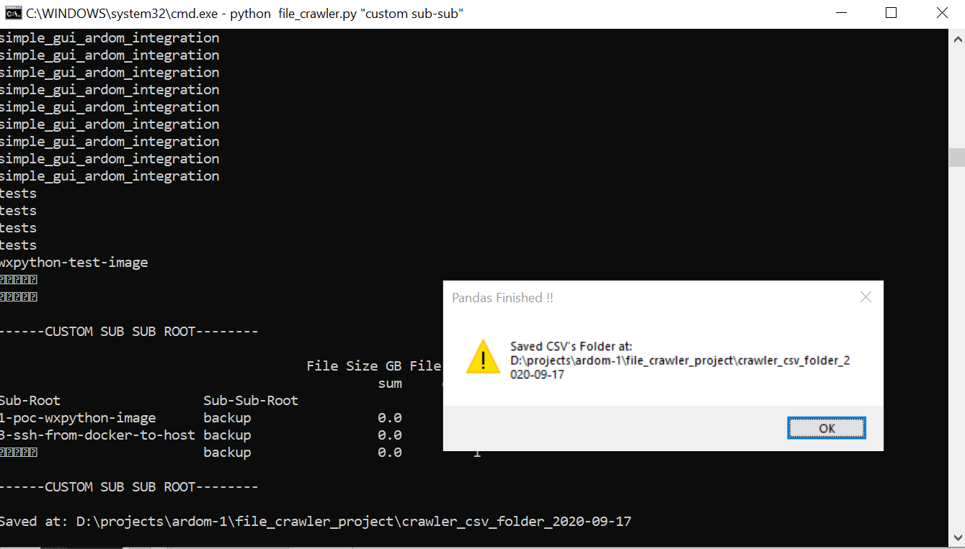
Next Step
After execution, an alert prompt will show, and will tell us where the results were saved.

Slide 7
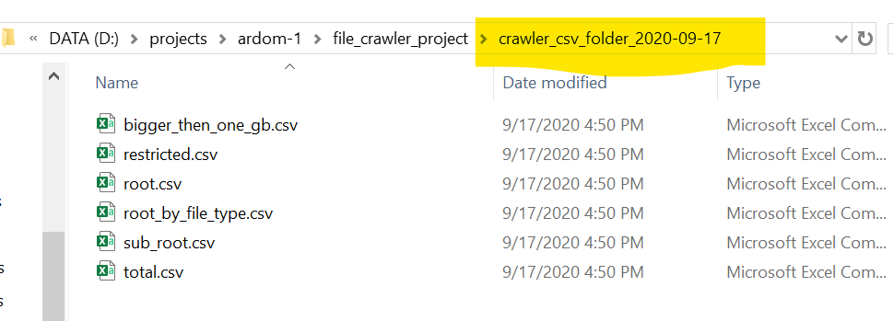
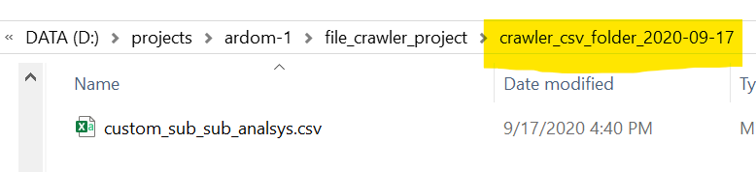
Results Dictionary
root_run.bat will return:
bigger_then_one_gb.csv – returns file types that
are bigger then 1 GB with sub-root specification
restricted.csv – will return a list of files that the script
didn’t have access to.
root.csv – returns sums of all file types from root
given with specification of year.
root_by_file_type.csv – returns sums of all file types
with specification on file type.
sub_root.csv – returns sums of all file types with
specification on sub-root and year.
total.csv – returns sums of files with
specification on sub-roots.

Slide 8
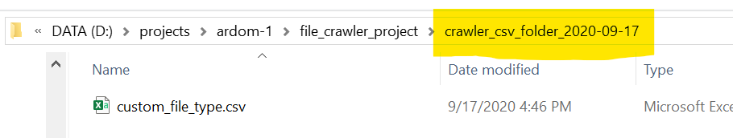
Results Dictionary
root_run.bat will return:
custom_file_type.csv – returns sums by sub-root that
are based on user inputed file types.
custom_sub_sub_ran.bat will return:
custom_sub_sub_analsys.csv – returns sums of
sub-sub-root given by user with sub-root specification.

